Slide 1

REA group presentation
https://valueflo.ws

Slide 2
REA group presentation
In this presentation….
Rethinking business software and software business with REA
REA pre-Valueflows software experiments past
Creating Valueflows v.0.5
Differences between Valueflows and “classical” REA
REA Valueflows software experiments present
Looking towards Valueflows v1.0

Slide 3
REA group presentation
Rethinking business software - 1990’s
ERP company skunkworks project: rethinking ERP, 1995
  Created https://en.wikipedia.org/wiki/Quick_Response_Engine
OOPSLA (Object-oriented Programming, Systems, Languages, and Applications) annual workshops:
  Radically distributed supply chain systems - 1997
    “The traditional business apps are dead. REA is the future.”
  Which business objects? - 1998
    “Should distributed business objects reproduce traditional business applications?”
    “In other words, are we building single or multi-agent systems?”

Slide 4
REA group presentation
Rethinking business software - 2000’s
ebXML and ISO (International Standards Org)– Bill McCarthy brings REA to the standards organizations.
  (Bob helps and learns a lot.)
Bob and some friends try a business software startup and fails.
Bob and Lynn retire and decide they will never again develop software that does not have live users.
  But they will use REA for everything.
With some other friends, they start working towards Valueflows

Slide 5
REA group presentation
REA pre-Valueflows software experiments
2 cohousing groups, and a timber network, all of which seem to be dead
4 food networks, two of which survived
Network Resource Planning software, developed with Sensorica in Montreal, https://www.sensorica.co/ a pioneering Open Value Network:
  http://nrp.sensorica.co/, software still alive
FairCoop, Freedom Coop, and Bank of the Commons in Europe
  https://www.facebook.com/thefaircoop/, some of the software still alive
Local Economic Analysis software started in Nova Scotia, software is now dead (but shall return)
  https://web.archive.org/web/20201202061046/http://locecon.org/nova-story/
Driftless Herbal Exchange Network, did not survive

Slide 6
REA group presentation
Valueflows v0.5
Started work in 2015, initiated within the Open App Ecosystem, a group of developers interested in building “a suite of interoperable, open source tools which support transparent, democratic, and decentralized organizing”
Had many inputs, based on REA implementations and other perspectives
Many hours and a few years later...
Got a version good enough for friendly projects to use

Slide 7
REA group presentation
Valueflows vs REA
Has REA at its core
  Has other inputs as part of a collaborative process to create a standard
  Explicitly exists to support “solidarity economy” experiments, in addition to conventional accounting
Focused on software implementations
  Every software implementation has real-world user networks
Has a Resource Description Framework (RDF) “system of record”
But is technology agnostic, supports semantic web and anything else
Has a graphql protocol definition, will have others

Slide 8
REA group presentation
Valueflows vs REA Resources
“Classical” REA:
  Economic Resources are (1) scarce and (2) under the control of an enterprise.
Valueflows REA:
  Intellectual creations like designs are not scarce, yet they are economic resources. They only become scarce when legally restricted.
  Air and water are economic resources, but they are not under the control of an enterprise unless they are legally restricted. Things currently considered “externalities” are accounted as economic resources.

Slide 9
REA group presentation
Valueflows vs REA Events
“Classical” REA:
  Economic Events can have multiple steps with resources by step.
Valueflows REA:
  Economic Events are inputs and outputs of Processes, each event affecting 1 Economic Resource, OR
  Economic Events are transfers between 2 Agents or moves within 1 Agent, that can affect 2 Economic Resources (from and to).
  In other words, modeled more like an REA “stockflow”.

Slide 10
REA group presentation
Valueflows vs REA Agents
“Classical” REA:
  Economic agents can be Persons or Economic Units.
Valueflows REA:
  Agents can be Persons or Organizations, broader but basically the same.
  Agents can also be kinds of ecological agents, which is being worked out now. This is intended to reflect a need to re-think how we conceive of and relate to other living beings and living ecosystems; reflecting some of the world’s indigenous thinking. It is driven by a desire for climate accounting.

Slide 11

REA group presentation
Valueflows Additions to REA
Recipes
Intents (Offers and Requests)
A number of implementation details and edge case support

Slide 12
REA group presentation
Current Valueflows software projects
Distributed technical ecosystems that are implementing Valueflows
  Holochain
  Fediverse (federated network)
Other individual projects
We are working with the user groups and the software development organizations, to varying degrees
They often talk to each other to coordinate protocols and share understanding

Slide 13
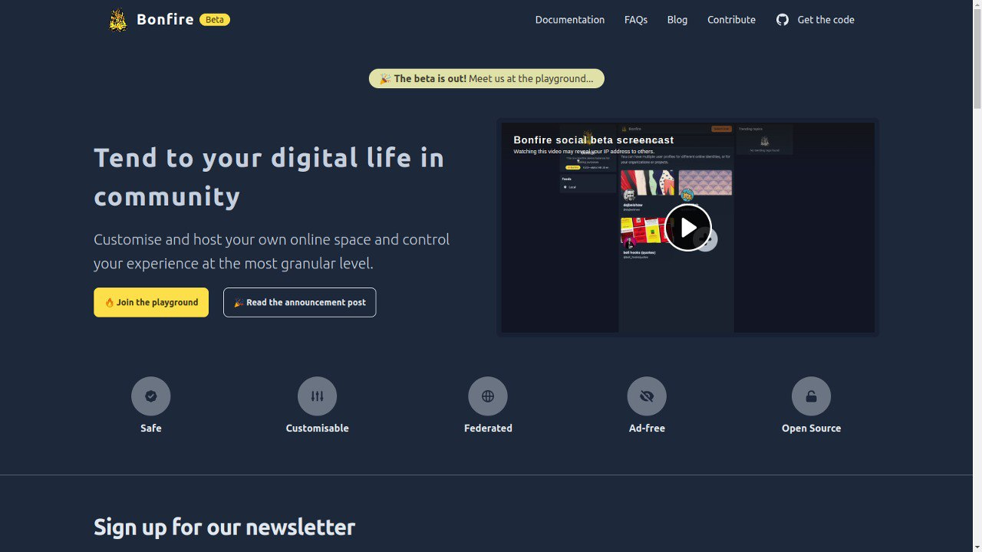
REA group presentation
Bonfire Social + Economic Networking framework
Bonfire is part of the
“fediverse”, a set of federated social networking applications, which is expanding to include other apps, including economic networking. Bonfire is a framework, designed to be modular and support many user applications.
https://bonfirenetworks.org/

Slide 14
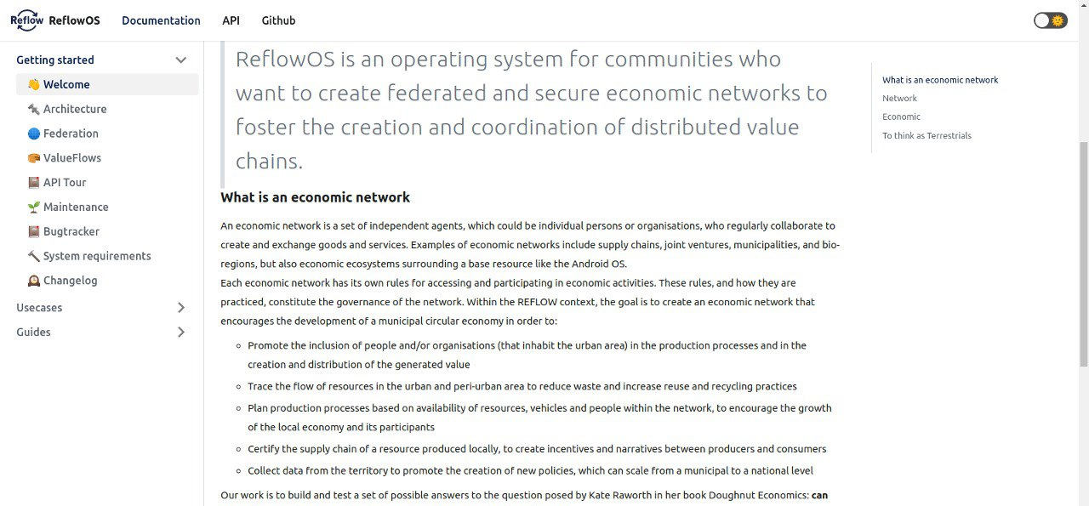
REA group presentation
Reflow EU-funded circular economy project
https://reflowproject.eu/ ReflowOS developed by https://www.dyne.org/

Slide 15
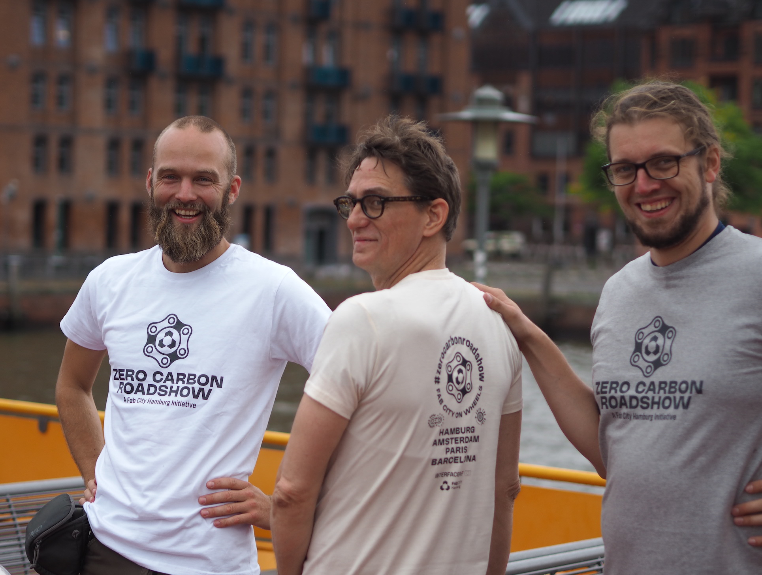
REA group presentation
FabCity Hamburg: Zero Carbon Road Show
The Zero Carbon Roadshow is one of the outreach activities of the INTERFACER project: In order to build a digital infrastructure for Fab Cities, a global initiative for productive, resilient, open cities, an initial network of social relationships based on trust and personal contacts is needed. On the other hand, it aims to create a strong narrative to communicate the underlying values of the Fab City and INTERFACER’s core product, the Fab City Operating System (OS), to a broad public.
https://fab.city/ FabCity OS, also being developed by https://www.dyne.org/

Slide 16
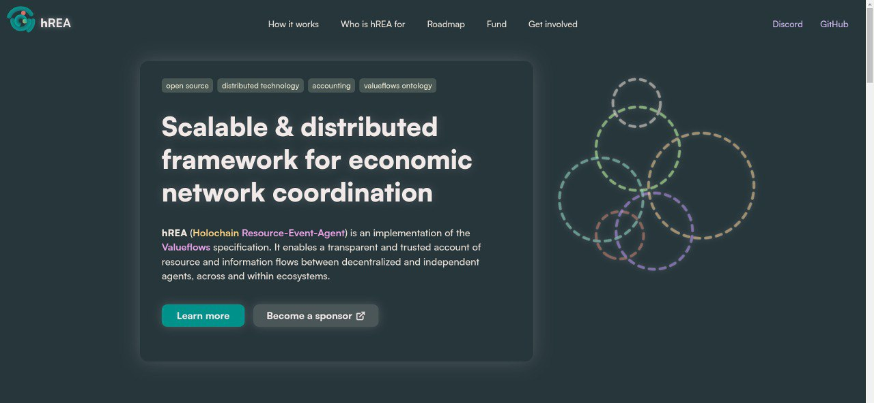
REA group presentation
hREA economic framework in Holochain
https://hrea.io/
part of the Holochain ecosystem, which is starting to embrace REA

Slide 17
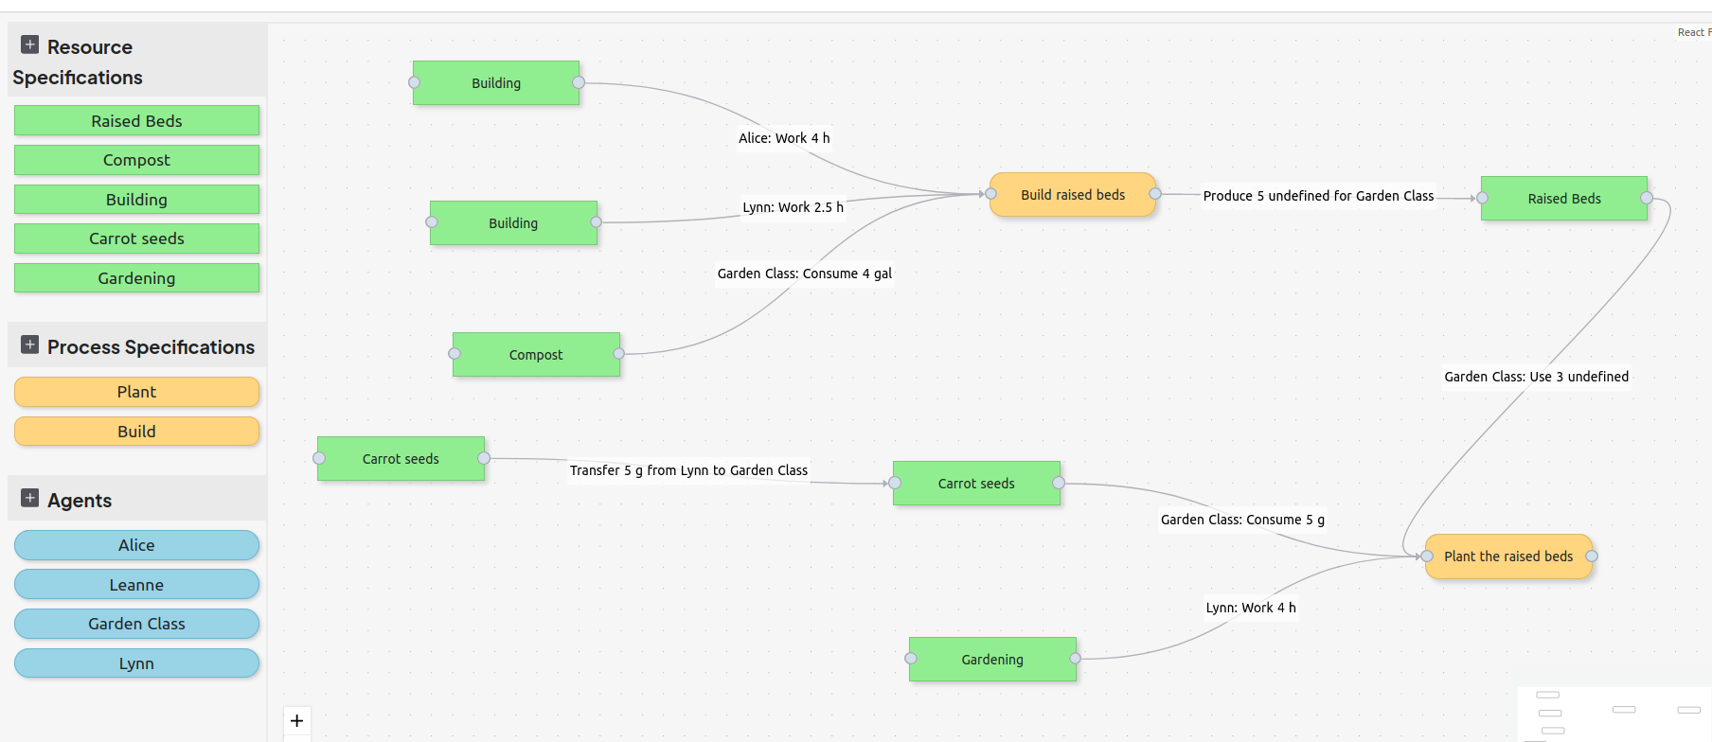
REA group presentation
REA Playspace in Holochain
Teacher+student garden project at Bard and other universities

Slide 18
REA group presentation
User projects that will build on hREA framework
New York Textile Lab, a farm to textiles supply chain network in the Hudson Valley NY
Code A, an international group of university professors interested in climate accounting and climate education, piloting at Bard Simon’s Rock in New York, and using the REA Playspace
Sensorica would like to do NRP 2 on hREA/Holochain, and is in the design phase now
There are other projects interested, increasing funding commitments, and further outreach planned….

Slide 19
REA group presentation
Other initiatives using Valueflows
LearnDeep, a high-school fablab network in Milwaukee
  Started with NRP, now building on Bonfire
  Development done by students at MSOE
Basis Project, a protocol for scalable, ecological production
Web of Needs, automated matching of intents

Slide 20
REA group presentation
Towards Valueflows v1.0
Several projects embraced REA and Valueflows
We have helped them with Valueflows and learned from them
Loooong process of those projects completing, starting to happen now
People want to use REA and Valueflows to think about climate accounting
People are pushing for a stable version
We are thinking about what kind of organization is needed to support Valueflows into the future

